Slide 1
Q1 Project Report: Heart Disease Predictive Model
Adarsh B, Aryan G
10/21/2024

Slide 2
Table of Contents
Part 1 – Statement/Project Goal
Part 2 – Description of Dataset
Part 3 – Pre-Processing
Part 4 – Attribute Selection Algorithms & Model Classifiers Used
Part 5 - Results
Part 6 - Analysis
Part 7 - Conclusion & Steps to Reproduce
Part 8 – Appendix and Sources

Slide 3
Project Goal

Slide 4
Project Goal
Heart Disease Overview: 695,000 people die annually from heart disease in the U.S., which is 1 out of 5 deaths.
Preventability: 1 in 3 of these deaths could have been prevented with earlier diagnosis.
Dataset: Combined heart disease dataset from five sources: Hungarian, Cleveland, Switzerland, Long Beach VA, and Statlog (Heart) Data Set.
Objective: Use the combined dataset to predict if an individual has heart disease based on key medical attributes, contributing to early diagnosis and improved healthcare outcomes.
Notes:
Adarsh

Slide 5
2. Dataset

Slide 6
Dataset Overview
File: heart.csv
Instances (Rows): 1190
Attributes (Columns): 11 (non-class)
Missing Values:
Few Disguised
Class Attribute: "target"
Class Distribution:
Class 0: No heart disease (47.1%)
Class 1: Heart disease (52.9%)
Notes:
Adarsh

Slide 7
Dataset Attributes
Age: Age of the patient
Sex: Gender (1 = Male, 0 = Female)
Chest Pain Type: Typical-Angina, Non-Typical-Angina
Resting BP: Resting blood pressure (mmHg)
Cholesterol: Serum cholesterol (mg/dl)
Fasting Blood Sugar: >120 mg/dl (1 = True, 0 = False)
Notes:
Adarsh

Slide 8
Dataset Attributes Cont.
Resting ECG: Electrocardiographic results (0, 1, 2)
Max Heart Rate: Max heart rate achieved
Exercise Angina: (1 = Yes, 0 = No) (Chest Pain)
Oldpeak: ST depression (Amount HR Decrease After Exercise)
ST Slope: Slope of peak exercise ST segment (Positive, Flat, Negative)
Notes:
Adarsh

Slide 9
3. Pre-Processing

Slide 10
Pre-Processing
Handling Disguised Entries:
Replaced cholesterol values of 0 (172 instances) with the median value of 210.
Replaced resting BP values of 0 (5 instances) with the mean value of 132.
Normalization:
Min-max normalization for age, BP, cholesterol, max heart rate, oldpeak, ST slope.
Train-Test Split: 85% training set, 15% testing set, with 1012 training instances and 178 test instances.
Notes:
Adarsh

Slide 11
4. Selection Algorithms & Model Classifiers

Slide 12
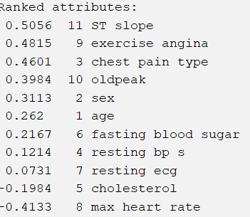
Attribute Selection: Method 1
Method: Correlation analysis
Criteria: Selected attributes with absolute correlation > 0.3
Selected Attributes: ST slope, exercise angina, chest pain type, oldpeak, sex, max heart rate
Notes:
Aryan

Slide 13
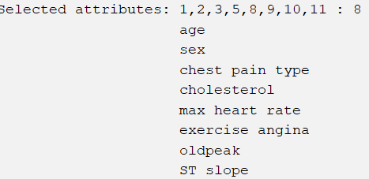
Attribute Selection: Method 2
Method: Cfs subset evaluation
Description: Evaluates attributes based on accuracy and minimizing redundancy through intercorrelation.
Selected Attributes: Age, sex, chest pain type, cholesterol, max heart rate, exercise angina, oldpeak, ST slope
Notes:
Aryan

Slide 14
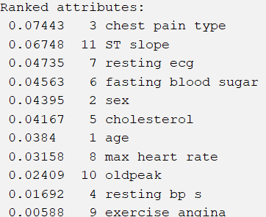
Attribute Selection: Method 3
Method: Relief Attribute Evaluator
Description: Evaluates attributes by determining how well they separate similar and different class instances. It works well for both discrete and continuous data.
Criteria: Value > 0.04
Selected Attributes: Chest pain type, ST slope, Resting ECG, Fasting blood sugar, Sex, Cholesterol
Notes:
Aryan

Slide 15
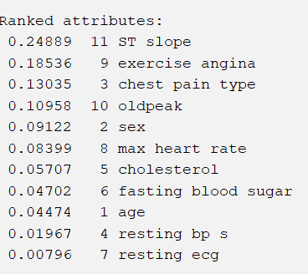
Attribute Selection: Method 4
Method: Gain Ratio Attribute Evaluator
Description: Measures the predictive power of attributes by using a decision tree and optimizing information gain to handle attributes with many distinct values.
Criteria: Value > .09
Selected Attributes: ST slope, Exercise angina, Chest pain type, Oldpeak, Sex
Notes:
Aryan

Slide 16
Attribute Selection: Method 5
Method: Self-Selected Attributes
Description: Manually selected based on underrepresentation in the other 4 and on intuition/familiarity, ensuring important variables are included in the prediction model.
Selected Attributes: Resting ECG, Age, Resting blood pressure, cholesterol, Max heart rate
Notes:
Aryan

Slide 17
Classifiers Used
- OneR: We used OneR as a simple baseline to measure the effectiveness of more complex classifiers.
- Random Forest: We chose Random Forest for its versatility and expected it to set a high standard across performance metrics.
- Naive Bayes: We used Naive Bayes to compare the performance of probabilistic and deterministic models.
- J48: We applied J48 to assess how a deterministic decision tree differs from the Random Forest non-deterministic approach.
Notes:
Adarsh

Slide 18
5. Results

Slide 19
Performance Metrics
- Accuracy: We used accuracy to get an overall view of model performance by pooling all correct predictions.
- TP Rate: We used TP rate to assess how well our models predict both False (No heart disease) and True (Heart disease).
- FP Rate: FP rate helped us measure the percentage of people misdiagnosed as having no heart disease when they actually do.
- AUC: We used AUC as it provides a balance between precision and recall, ideal for our balanced dataset.
- F-Measure: F-measure allowed us to evaluate the balance between precision and recall at the class level for a deeper analysis.
Notes:
Adarsh

Slide 20
Dataset 1 - Correlation Analysis
Summary Table for Dataset 1:
 | Performance Metric
Classifier Used |  | Accuracy | TP Rate (False/True) | FP Rate (False/True) | AUC | F-Measure (False/True)
 | OneR | .799 | .732 .856 | .144 .268 | .794 | .769 .822
 | Random Forest | .849 | .829 .866 | .134 .171 | .907 | .834 .862
 | Naive Bayes | .821 | .780 .856 | .144 .220 | .869 | .800 .838
 | J48 | .832 | .817 .845 | .155 .183 | .870 | .817 .845
Notes:
Aryan

Slide 21
Dataset 2 - CFS Subset Evaluation
Summary Table for Dataset 2:
 | Performance Metric
Classifier Used |  | Accuracy | TP Rate (False/True) | FP Rate (False/True | AUC | F-Measure (False/True)
 | OneR | .777 | .711 .833 | .167 .289 | .772 | .747 .800
 | Random Forest | .899 | .855 .938 | .063 .145 | .962 | .888 .909
 | Naive Bayes | .838 | .819 .854 | .146 .181 | .901 | .824 .850
 | J48 | .872 | .843 .896 | .104 .157 | .882 | .859 .882
Notes:
Aryan

Slide 22
Dataset 3 - Relief Attribute Evaluator
Summary Table for Dataset 3:
 | Performance Metric
Classifier Used |  | Accuracy | TP Rate (False/True) | FP Rate (False/True | AUC | F-Measure (False/True)
 | OneR | .771 | .707 .825 | .175 .293 | .766 | .739 .796
 | Random Forest | .950 | .927 .969 | .031 .073 | .970 | .944 .954
 | Naive Bayes | .855 | .841 .866 | .134 .159 | .914 | .841 .866
 | J48 | .872 | .780 .948 | .052 .220 | .878 | .848 .889
Notes:
Aryan

Slide 23
Dataset 4 - Gain Ratio Attribute Evaluator
Summary Table for Dataset 4:
 | Performance Metric
Classifier Used |  | Accuracy | TP Rate (False/True) | FP Rate (False/True | AUC | F-Measure (False/True)
 | OneR | .765 | .683 .835 | .165 .317 | .759 | .727 .794
 | Random Forest | .866 | .878 .856 | .144 .122 | .930 | .857 .874
 | Naive Bayes | .754 | .634 .856 | .144 .366 | .866 | .703 .790
 | J48 | .827 | .866 .794 | .206 .134 | .869 | .821 .832
Notes:
Aryan

Slide 24
Dataset 5 - Self-Selected Attributes
Summary Table for Dataset 5:
 | Performance Metric
Classifier Used |  | Accuracy | TP Rate (False/True) | FP Rate (False/True) | AUC | F-Measure (False/True)
 | OneR | .626 | .707 .557 | .443 .293 | .632 | .634 .617
 | Random Forest | .849 | .817 .876 | .124 .183 | .903 | .832 .863
 | Naive Bayes | .698 | .683 .711 | .289 .317 | .760 | .675 .719
 | J48 | .743 | .732 .753 | .247 .268 | .783 | .723 .760
Notes:
Aryan

Slide 25
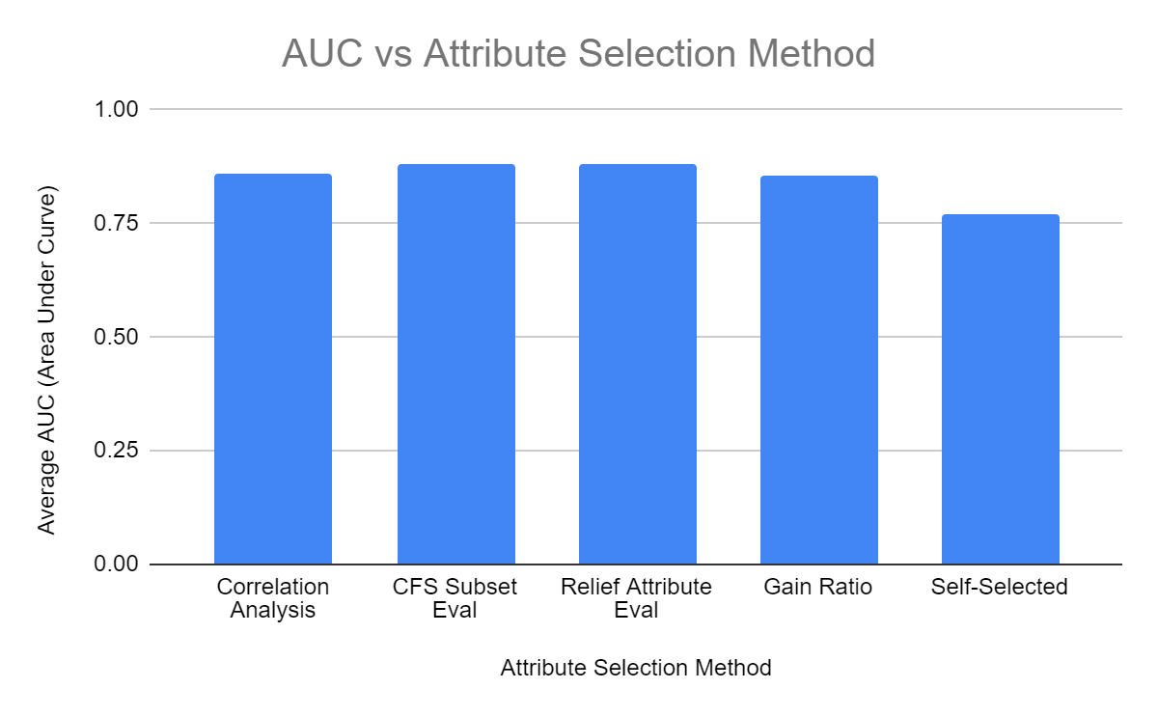
Notes:
Adarsh

Slide 26
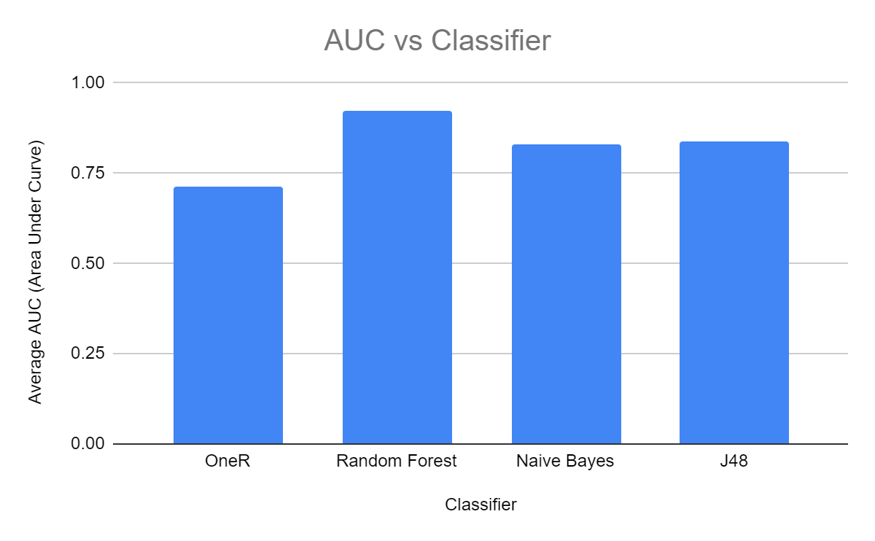
Notes:
Adarsh

Slide 27
AUC Per Test
 | Attribute Selection Algorithm
Classifier Used |  | Correlation Analysis | CFS Subset Eval | Relief Attribute Eval | Gain Ratio | Self-Select | AVG
 | OneR | .794 | .772 | .766 | .759 | .632 | .745
 | Random Forest | .907 | .962 | .970 | .930 | .903 | .934
 | Naive Bayes | .869 | .901 | .914 | .866 | .760 | .862
 | J48 | .870 | .882 | .878 | .869 | .783 | .856
 | AVG | .860 | .879 | .882 | .856 | .770
Notes:
Adarsh

Slide 28
6. Analysis

Slide 29
Classifier Performance Overview
Tested 20 classifiers using 4 models on 5 datasets from different attribute selection methods.
Random Forest on Dataset 3 (Relief Attribute Eval) achieved the highest AUC of ~97%.
Random Forest on Dataset 3 also had the highest TP rate for heart disease (96.9%), indicating it accurately identifies heart disease 97% of the time.
Notes:
Aryan

Slide 30
Key Comparisons and Findings
Random Forest and Naive Bayes performed best, with consistent high TP rates, but Random Forest outperformed in challenging datasets.
In Dataset 5 (self-selected attributes), Random Forest maintained 85% TP rate, while Naive Bayes dropped to 71.1%.
Naive Bayes struggled with unreliable data, while tree-based models like Random Forest and J48 performed better.
Notes:
Aryan

Slide 31
Attribute Selection Insights
ST Slope was consistently selected by all methods except self-selected, indicating its strong correlation with heart disease.
Relief Attribute Eval (Method #3) outperformed CFS Subset Eval (Method #2) in both Random Forest and Naive Bayes models.
Conclusion: Relief Attribute Eval was the best attribute selection method, with Random Forest as the top-performing model.
Notes:
Aryan

Slide 32
7. Conclusion

Slide 33
Best Model and Future Improvements
Top Model: Relief Attribute Eval with Random Forest achieved the highest AUC (0.970) and a 96.9% True Positive rate for heart disease.
Consistency: All classifiers, including OneR, had over 75% accuracy, but Random Forest was the most reliable.
Limitations: Using Weka limited us to basic classifiers; for further improvement, we would explore deep neural networks, especially for handling continuous data, as our current models like OneR are not optimized for that.
Notes:
Adarsh

Slide 34
8. Sources

Slide 35
Sources
Data Source Website:
https://www.kaggle.com/datasets/mexwell/heart-disease-dataset
Files Attached in Google Drive:
arf copies - Pre-processed files used to create models
original csv files - Original data from the source
make_sets.py - Code to split data into 5 datasets with train and test
Sources:
Eibe Frank, Mark A. Hall, and Ian H. Witten (2016). The WEKA Workbench. Online Appendix for "Data Mining: Practical Machine Learning Tools and Techniques", Morgan Kaufmann, Fourth Edition, 2016.
Mark Hall, Eibe Frank, Geoffrey Holmes, Bernhard Pfahringer, Peter Reutemann, and Ian H. Witten (2009). The WEKA Data Mining Software: An Update. SIGKDD Explorations, Volume 11, Issue 1.

Slide 36
Questions?

